Slide 1
Part 2.4: Rules that Govern Symmetry

Slide 2
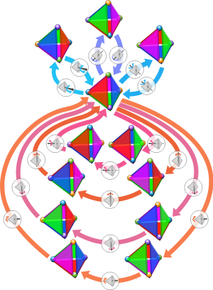
Outline
Define Group Theory
The Rules for Groups
Combination Tables
Additional Rules/Definitions
Subgroups
Representations
Reducible
Irreducible
Similarity Transformations
Conjugates
Classes

Slide 3
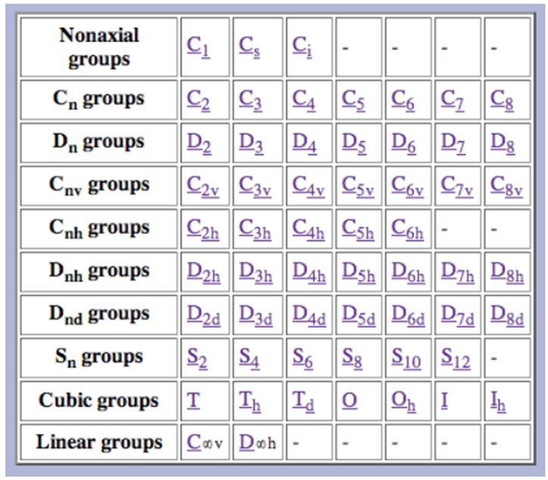
Point Groups
Nonaxial (no rotation)
- C₁, C_{s}, C_{i}
Cyclic (rotational)
-C_{n}, C_{nv}, C_{nh}, S_{n}
Dihedral (⊥C₂)
- D_{n}, D_{nd}, D_{nh}
Polyhedral
- T, T_{h}, T_{d}, O, O_{h}, I, I_{h}
Linear
- C_{∞v}, D _{∞h}
Symmetry elements and operation defined by a group.
Behavior dictated by group theory!

Slide 4
Group Theory
Group theory studies the algebraic structures known as groups.
Group- a set of elements together with an operation that combines any two of its elements to form a third element satisfying four conditions called the group axioms, namely closure, associativity, identity and invertibility.
Does not have to be symmetry operations and elements!
Example: All integers with the addition operation form a group.
Elements: -n … -3, -2, -1, 0, 1, 2, 3, … n
Operation: addition (+)

Slide 5
Group Theory History
Early group theory driven by the quest for solutions of polynomial equations of degree higher than 4.
Late 1700s- Joseph-Louis Lagrange (1736-1813)proved that every natural number is a sum of four squares (Theorie des fonctions analytiques).
Early 1800s- Évariste Galois (1811-1832) realized that the algebraic solution to a polynomial equation is related to the structure of a group of permutations associated with the roots of the polynomial, the Galois group of the polynomial.
2x⁵ + 3x⁴ – 30x³ – 57x² – 2x + 24
Late 1800s- Felix Klein used groups to organize hyperbolic and projective geometry them in a more coherent way.
1920s- Group theory applied in physics and chemistry.
1931- It is often hard or even impossible to obtain a solution to the Schrodinger equation-however, a large part of qualitative results can be obtained by group theory. Almost all the rules of spectroscopy follow from the symmetry of a problem.
-Eugene Wigner (1963 Nobel Prize in Physics)
Notes:
gal-wa
wigner-described elementary particles through the application of symmetry.

Slide 6
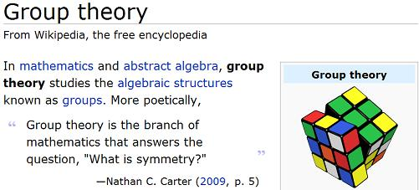
What is Group Theory?
Group theory studies the algebraic structures known as groups.
[Group theory] is a collection (set) of symbols or objects together with a rule telling us how to combine them.”
-Hargittai, Istvan and Hargittai
[Group theory] is a branch of mathematics in which one does something to something and then compares the result with the result obtained from doing the same thing to something else, or something else to the same thing.
–Mathematician James Newman

Slide 7
Group Theory in Chemistry
Is a mathematical formalism for describing all symmetry aspects of a molecule/crystal.
A group consists of a set of symmetry elements (and associated symmetry operations) that completely describe the symmetry of a molecule.
Rationalize and simplify many problems in chemistry.
We will use group theory to help us understand the bonding and spectroscopic features of molecules.

Slide 8
Rules that Govern Groups
The product of any two elements of the group is itself an element of the group.
The associative law is valid.
There exists an identity element.
For every element there exists an inverse.

Slide 9
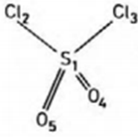
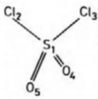
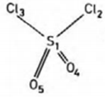
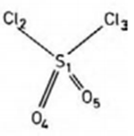
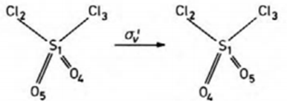
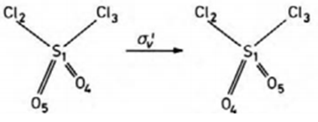
Rules that Govern Groups
The product of any two elements of the group is itself an element of the group.
C_{2v} point group
Perform First
SO₂Cl₂
Perform Second
σ_{v}’
σ_{v}’
C₂ • σ_{v} = __
σ_{v} • C₂ = __
For C_{2v} order does not matter (Abelian Group)!

Slide 10
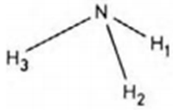
Rules that Govern Groups
The product of any two elements of the group is itself an element of the group.
C_{3v} point group
Perform First
NH₃
Perform Second
C₃⁻
σ_{v}
C₃ • σ_{v}’’ = __
σ_{v}’’ • C₃ = __
For C_{3v} order does matter (non-Abelian Group)!

Slide 11
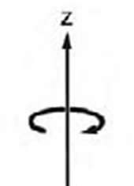
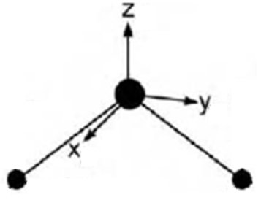
Rules that Govern Groups
2) The associative law is valid.
Associative Law-
For all elements in a group
P Q R = P (Q R) = (P Q) R
is True
For C_{2v} point group:
σ_{v}’ C₂ σ_{v} = σ_{v}’ (C₂ σ_{v}) = (σ_{v}’ C₂) σ_{v}
C₂
σ_{v}’ C₂ σ_{v} (1, 2) = σ_{v}’ C₂ (2, 1) = σ_{v}’ (1, 2) = (1, 2)
σ_{v}’
σ_{v}’ (C₂ σ_{v} (1,2)) = σ_{v}’ (C₂ (2,1)) = σ_{v}’ (1,2) = (1, 2)
(σ_{v}’ C₂) σ_{v} (1,2) = σ_{v} σ_{v} (1,2) = σ_{v} (2,1) = (1, 2)
1
2
σ_{v}
From Rule 1: (σ_{v}’ C₂) = σ_{v}

Slide 12
Rules that Govern Groups
3) There exists an identity element (E).
One element in the group must commute with all other elements in the group and leave them unchanged.
E • X = E • X = X
Identity Matrix

Slide 13
Rules that Govern Groups
4) For every element there exists an inverse.
One element in the group must commute with another to generate the identity.
For C_{2v} point group:
C₂
E • E = E
σ_{v}’
C₂ • C₂ = E
σ_{v} • σ_{v} = E
1
2
σ_{v}
σ_{v}’ • σ_{v}’ = E

Slide 14
Rules that Govern Groups
The product of any two elements of the group is itself an element of the group.
The associative law is valid.
There exists an identity element.
For every element there exists an inverse.

Slide 15
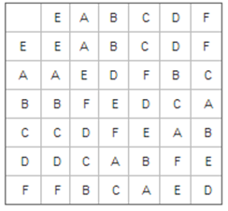
Rules that Govern Groups
The product of any two elements of the group is itself an element of the group.
The associative law is valid.
There exists an identity element.
For every element there exists an inverse.

Slide 16
Combination Table
(Multiplication)
Applied First
This table has n = 6 elements (E, A, B, C, D, F)
Each element is listed once in the first row/column
Top column applied first and then the row
n² possible combination (36)
Rearrangement theorem- every element will only appear once in a row or column
If the table is symmetric on the diagonal the group is Abelian.
Applied Second
D • C = B
C • D = A
method for combining elements
- addition
- subtraction
multiplication
anything
If
D • C = C • D
then the group is Abelian.

Slide 17
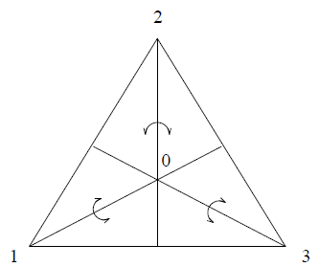
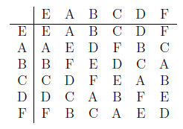
Example: A-F
Object
Operations
Initial Position
Final Position
2
1
3
Applied First
E • E =
•
E
•
E
•
□
◊
□
◊
□
◊
Applied Second
E

Slide 18
Example: A-F
Object
Operations
Initial Position
Final Position
Applied First
E • A =
•
A
□
E
□
□
◊
•
◊
•
◊
Applied Second
A

Slide 19
Example: A-F
Object
Operations
Initial Position
Final Position
Applied First
E • X = X
•
X
B
E
B
□
◊
A
C
A
C
Applied Second
X

Slide 20
Example: A-F
Object
Operations
Initial Position
Final Position
Applied First
A • E =
•
E
•
A
□
□
◊
□
◊
•
◊
Applied Second
A

Slide 21
Example: A-F
Object
Operations
Initial Position
Final Position
Applied First
X • E =
•
E
•
X
B
□
◊
□
◊
A
C
Applied Second
X

Slide 22
Example: A-F
Object
Operations
Initial Position
Final Position
Applied First
A • D =
•
D
□
A
◊
□
◊
◊
•
□
•
Applied Second
B

Slide 23
Example: A-F
Object
Operations
Initial Position
Final Position
Applied First
Applied Second

Slide 24
Example: A-F
Operations
Does it obey the rules?
The product of any two elements of the group is itself an element of the group.
The associative law is valid.
There exists an identity element.
For every element there exists an inverse.
Initial Position
Final Position
Object
Applied First
Applied Second

Slide 25
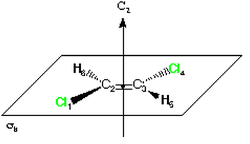
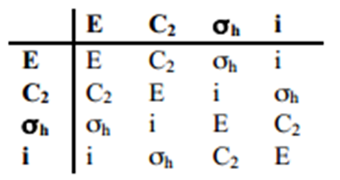
Example: C_{2h}
Object
Does it obey the rules?
The product of any two elements of the group is itself an element of the group.
The associative law is valid.
There exists an identity element.
For every element there exists an inverse.
Elements (C_{2h})
Applied First
C_{2h}
Applied Second

Slide 26
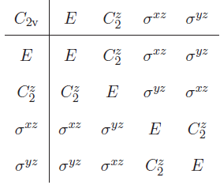
Example: H₂O (C_{2v})

Slide 27
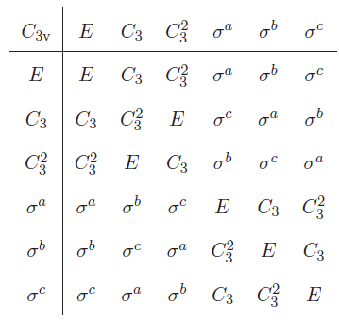
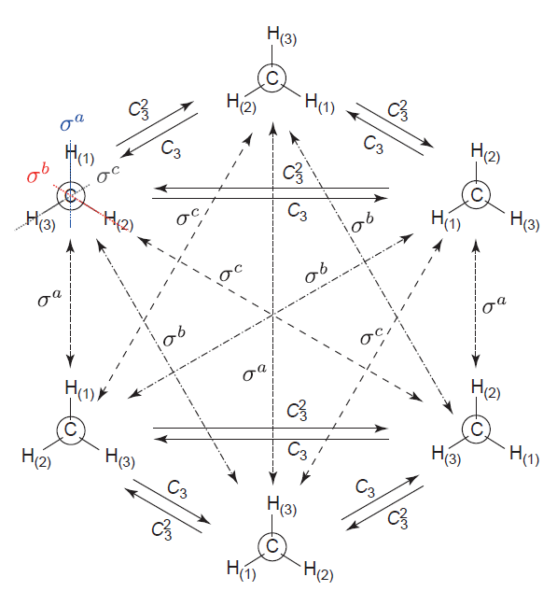
Example: CH₃Cl (C_{3v})

Slide 28
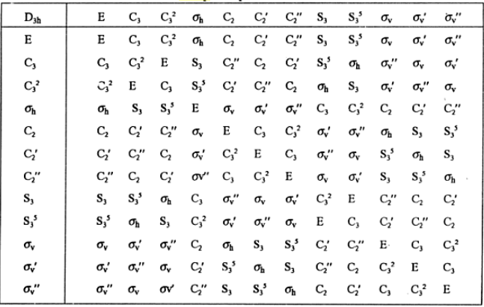
Example: D_{3h}
For D_{3h} order does not matter (Abelian Group).

Slide 29
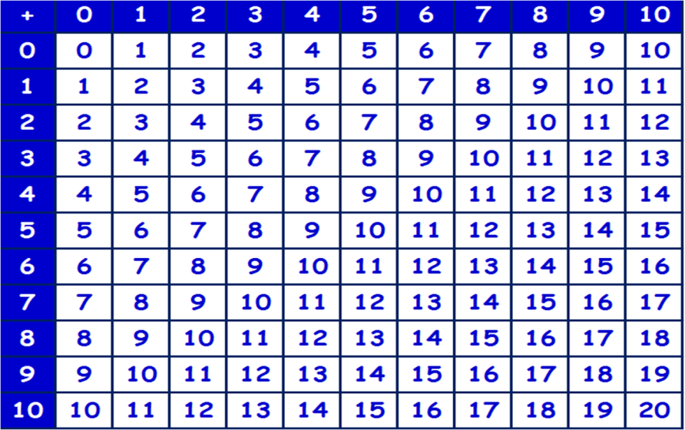
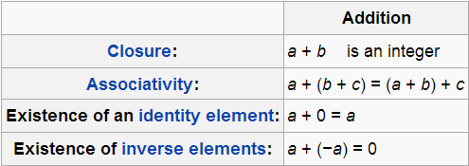
Rules that Govern Groups
The product of any two elements of the group is itself an element of the group.
The associative law is valid.
There exists an identity element.
For every element there exists an inverse.
Example: All integers with the addition operation form a group.
Elements: -n … -3, -2, -1, 0, 1, 2, 3, … n
Operation: addition (+)

Slide 30
Rules that Govern Groups
The product of any two elements of the group is itself an element of the group.
The associative law is valid.
There exists an identity element.
For every element there exists an inverse.

Slide 31
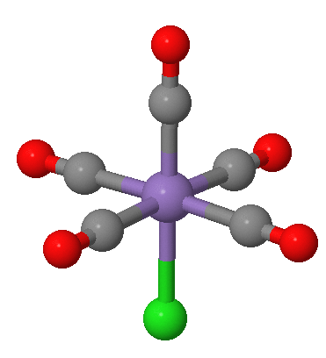
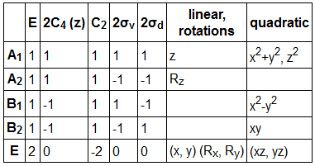
Point Groups and Group Theory
[MnCl(CO)₅]
Eiffel Tower
C_{4v}
Operations
C₄
C₂
C₄⁻
σ_{v2}
σ_{d2}
σ_{v1}
σ_{d1}
Symmetry operations obey the rules of group theory.

Slide 32
Additional Rules/Definitions
Subgroups
Representations
Reducible
Irreducible
Basis Functions
Similarity Transformations
Conjugates
Classes

Slide 33
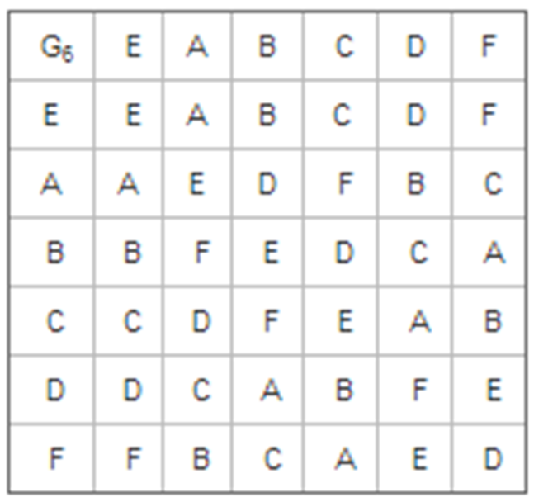
Subgroups
A subgroup is a smaller group within a group that still possesses the four fundamental properties of a group.
-The identity operation, E, is always a subgroup by itself.
-The ratio of the order of the group (g) to the order of the subgroup (s) is an integer.
g/s = integer
Order (h) = # of elements in a group.
E, A, B, C, D, F
order (h) = 6
Subgroup order can be 3, 2 and/or 1.

Slide 34
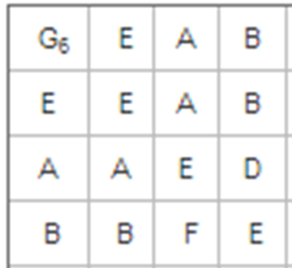
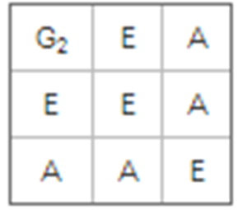
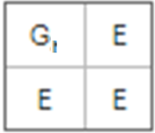
Subgroups
Order (h) = 6
The Rules:
The product of any two elements of the group is itself an element of the group.
The associative law is valid.
There exists an identity element.
For every element there exists an inverse.
Subgroup order can be order 3, 2 and/or 1.
Rule 1
order (h) = 1
order (h) = 2
order (h) = 3
Is a group/subgroup.
Is a group/subgroup.
Is NOT a group/subgroup.

Slide 35
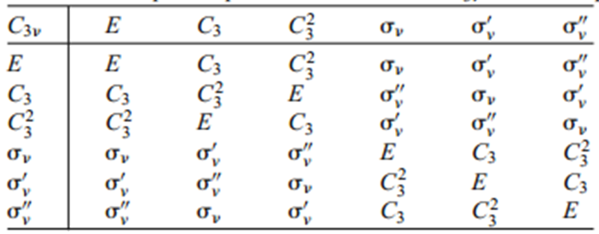
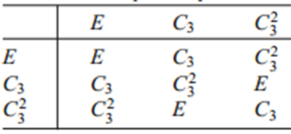
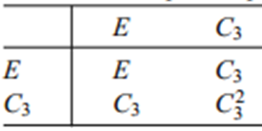
Subgroups
The Rules:
The product of any two elements of the group is itself an element of the group.
The associative law is valid.
There exists an identity element.
For every element there exists an inverse.
Order (h) = 6
Subgroup order can be order 3, 2 and/or 1.
C₃
C₁
order (h) = 1
order (h) = 2
order (h) = 3
Is a group/subgroup.
Is NOT a group/subgroup.
Is a group/subgroup.

Slide 36
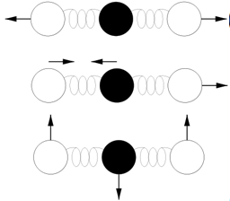
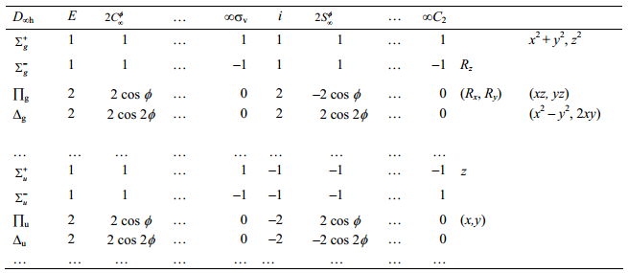
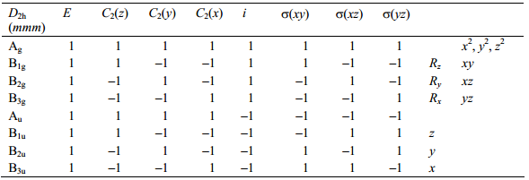
Why Subgroups?
Vibrational Modes of CO₂
D_{∞h} Character Table
D_{2h} Character Table
D_{2h} is a subgroup of D_{∞h}
Sometimes close is good enough!

Slide 37
Additional Rules/Definitions
Subgroups
Representations
Reducible
Irreducible
Basis Functions
Similarity Transformations
Conjugates
Classes

Slide 38
Representations (Γ)
Any collection of quantities (or symbols) which obey the multiplication table of a group is a representation of that group.
For our purposes these quantities are the matrices that show how certain characteristics of a molecule behave under the symmetry operations of the group.
Irreducible Representation
Reducible Representation

Slide 39
Reducible Representations (Γ)
A representation of a symmetry operation of a group.
CAN be expressed in terms of a representation of lower dimension.
CAN be broken down into a simpler form.
Characters CAN be further diagonalized.
Are composed of the direct sum of irreducible representations.
Infinite possibilities.

Slide 40
Irreducible Representation
A fundamental representation of a symmetry operation of a group.
CANNOT be expressed in terms of a representation of lower dimension.
CANNOT be broken down into a simpler form.
Characters CANNOT be further diagonalized.
Small finite number dictated by the point group.
The goal: Find a reducible representation and convert it into irreducible representations.

Slide 41
Additional Rules/Definitions
Subgroups
Representations
Reducible
Irreducible
Basis Functions
Similarity Transformations
Conjugates
Classes

Slide 42
Basis Functions
Reducible and irreducible representations of what?
A representation shows how certain characteristics of an object behave under the symmetry operations of the group.
certain characteristics of an object = basis
How does (basis) behave under the operations of C_{4v}?
Basis:
bolts in the frame
security guards
stairwells
open spaces
cameras
restrooms
Eiffel Tower (C_{4v})

Slide 43
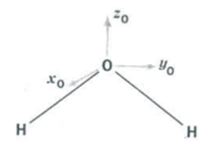
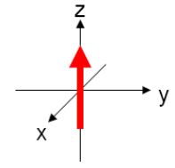
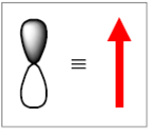
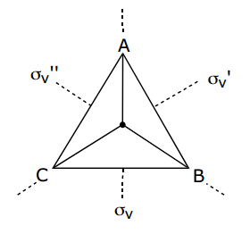
Basis Functions
How does (basis) behave under the operations of (point group)?
For molecules/materials:
atoms
cartisian coordinates
orbitals
rotation direction
bonds
angles
displacement vectors
plane waves
C₃

Slide 44
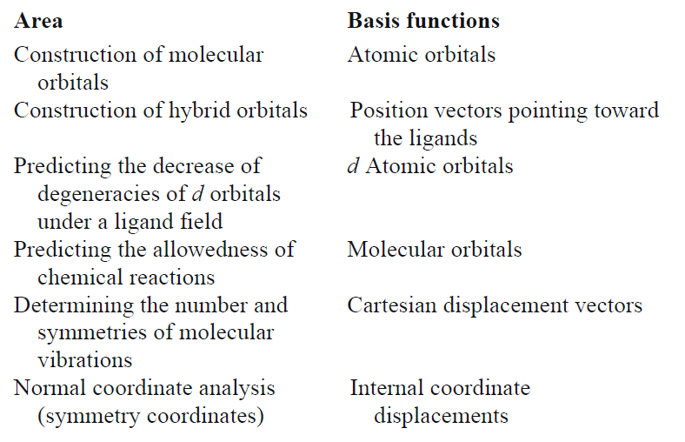
Basis Functions

Slide 45
Additional Rules/Definitions
Subgroups
Representations
Reducible
Irreducible
Basis Functions
Similarity Transformations
Conjugates
Classes

Slide 46
Similarity Transformations
Similarity transformations-
ν⁻¹ • A • ν = A’
A is a representation for some type of symmetry operation
ν is a similarity transform operator
ν⁻¹ is the inverse of the similarity transform operator
A’ is the product
A and A’ are conjugates.
A’ is the similarity transform of A by ν
Block diagonalizing a matrix
Find conjugate elements and classes

Slide 47
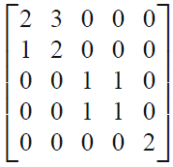
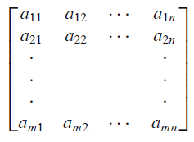
Block Diagonalizing a Matrix
A block-diagonal matrix has nonzero values only in square blocks along the diagonal from the top left to the bottom right
A
A’
ν⁻¹ •
• ν
=
non-block diagonal
block diagonal

Slide 48
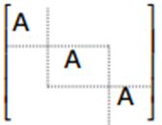
Block Diagonalizing a Matrix
Similarity transformation 1:
A
A’
Reducible Representation
ν⁻¹ •
• ν
=
Similarity transformation 2:
A₁’
A₁
11
ν₁⁻¹ •
• ν₁’
=
12
13
Similarity transformation n:
A_{n}’
Irreducible Representation
A_{n}
n1
ν₁⁻¹ •
• ν₁’
=
n2
n3
Notes:
Similarity transformation does not block diagonalize the matrix, then irreducible

Slide 49
Block Diagonalizing a Matrix
ν⁻¹ • A • ν = A’

Slide 50
Block Diagonalizing a Matrix
Direct Sum
Used to make character tables.

Slide 51
Conjugate elements and classes
Conjugate elements- Two element, X and Y, are conjugate if the following equality holds:
Z⁻¹ • X • Z = Y
Every element is conjugated with itself (Z = identity)
If X is conjugated with Y, Y is conjugate with X.
If X is conjugated with Y and W, then Y and W are also conjugate.

Slide 52
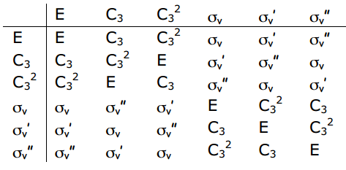
Conjugate elements and classes
Conjugate elements- Two element, X and Y, are conjugate if the following equality holds:
Z⁻¹ • X • Z = Y
C_{3v} point group-
E, C₃, C₃², σ_{v}, σ_{v}’, σ_{v}”
Find the conjugates to C₃
X = C₃
Z = E, C₃, C₃², σ_{v}, σ_{v}’, σ_{v}”
Z⁻¹ = inverse of E, C₃, C₃², σ_{v}, σ_{v}’, σ_{v}”
Z⁻¹ = E, C₃², C₃, σ_{v}, σ_{v}’, σ_{v}”

Slide 53
Conjugate elements and classes
Conjugate elements- Two element, X and Y, are conjugate if the following equality holds:
Z⁻¹ • X • Z = Y
Z⁻¹ • X • Z
Find the conjugates to C₃
X = C₃
Z = E, C₃, C₃², σ_{v}, σ_{v}’, σ_{v}”
Z⁻¹ = E, C₃², C₃, σ_{v}, σ_{v}’, σ_{v}”
For the C_{3v} point group-
C₃ is conjugate to C₃ and C₃²
C₃ and C₃² are in the same class!

Slide 54
Conjugate elements and classes
Classes- a complete set of elements of a group that are conjugate to one another.
Geometrical Definition: Operations in the same class can be converted into one another by changing the axis system through application of some symmetry operation of the group.
Mathematical Definition: The elements A and B belong to the same class if there is an element X within the group such that X^{‐1}AX = B, where X^{‐1} is the inverse of X (i.e., XX^{‐1} = X^{‐1}X = E).

Slide 55
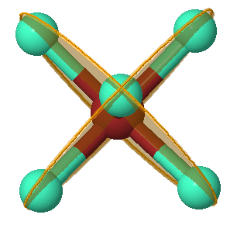
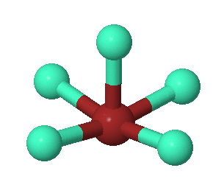
Conjugate elements and classes
Geometrical Definition: Operations in the same class can be converted into one another by changing the axis system through application of some symmetry operation of the group.
z
D
C
A
B
y
x
D
C
σ_{v2}
σ_{v1}
σ_{v2}
σ_{v1}
x
A
B
D
C
D
C
C₄
C_{4v} point group-
B
B
A
A
E, 2C₄, C₂, σ_{v1}, σ_{v2}, σ_{d2}, σ_{d2}
y
x
y
σ_{v1} ≈ σ_{v2}
σ_{v1} and σ_{v2} are the same class!

Slide 56
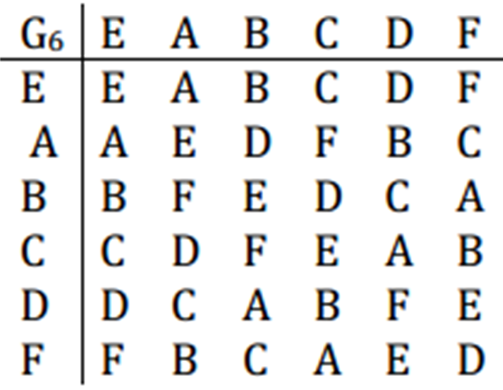
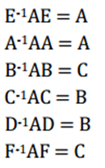
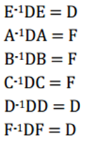
Conjugate elements and classes
Mathematical Definition: The elements A and B belong to the same class if there is an element X within the group such that X^{‐1}AX = B, where X^{‐1} is the inverse of X (i.e., XX^{‐1} = X^{‐1}X = E).
To find out what operations belong to the same class within a group, all possible similarity transformations in the group have to be performed.
For group G₆
X^{‐1}AX = Z
X^{‐1}DX = Z
A, B and C form a class of order 3
D and F form a class of order 2
X^{‐1}EX = E
E is in a class by itself.
In G₆ A, B and C behave similarly.

Slide 57
Conjugate elements and classes
Mathematical Definition: The elements A and B belong to the same class if there is an element X within the group such that X^{‐1}AX = B, where X^{‐1} is the inverse of X (i.e., XX^{‐1} = X^{‐1}X = E).
C_{3v} point group-
E, C₃, C₃², σ_{v}, σ_{v}’, σ_{v}”
X^{‐1} • C₃ • X = Z
E forms a class of order 1
C₃ and C₃² form a class of order 2

Slide 58
Conjugate elements and classes
Mathematical Definition: The elements A and B belong to the same class if there is an element X within the group such that X^{‐1}AX = B, where X^{‐1} is the inverse of X (i.e., XX^{‐1} = X^{‐1}X = E).
C_{3v} point group-
E, C₃, C₃², σ_{v}, σ_{v}’, σ_{v}”
X^{‐1} • σ_{v} • X = Z
E forms a class of order 1
C₃ and C₃² form a class of order 2
σ_{v}, σ_{v}’, and σ_{v}” form a class of order 3

Slide 59
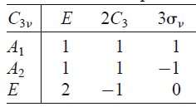
Classes in Character Tables
C_{3v} point group-
E forms a class of order 1
C₃ and C₃² form a class of order 2
E, C₃, C₃², σ_{v}, σ_{v}’, σ_{v}”
σ_{v}, σ_{v}’, and σ_{v}” form a class of order 3
Rotational Class
Reflection Class
Additional properties:
1) no operator occurs in more than one class
2) order of all classes must be integral factors of the order of the group
3) in an Abelian group, each operator is in a class by itself
4) E and I are always in classes by themselves
5) Rotation and inverse rotation are always the same class

Slide 60
Classes in Character Tables
C_{2h} point group-
O_{h} point group-
Abelian
Additional properties:
1) no operator occurs in more than one class
2) order of all classes must be integral factors of the order of the group
3) in an Abelian group, each operator is in a class by itself
4) E and I are always in classes by themselves
5) Rotation and inverse rotation are always the same class

Slide 61
Outline
Define Group Theory
The Rules for Groups
Combination Tables
Additional Rules/Definitions
Subgroups
Representations
Reducible
Irreducible
Similarity Transformations
Conjugates
Classes

